Slide 1
THG Simulations
Project update: follow-up
Week 3B
11/08/2023
David Amorim

Slide 2
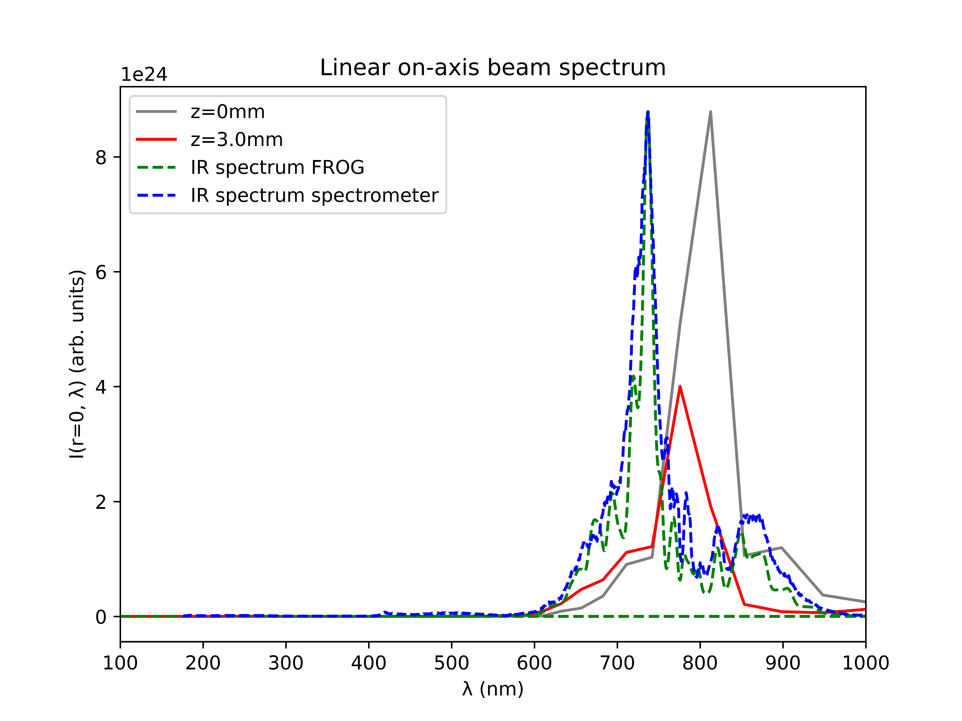
Comparison of spectra
IR spectrum calculated from FROG largely agrees with IR spectrum measured by spectrometer
The shape of the spectra also agree with the simulated IR spectrum (grey)
However, the measured spectra are centred around 730nm, not 800nm
Set the central wavelength to 730nm in the simulations?

Slide 3
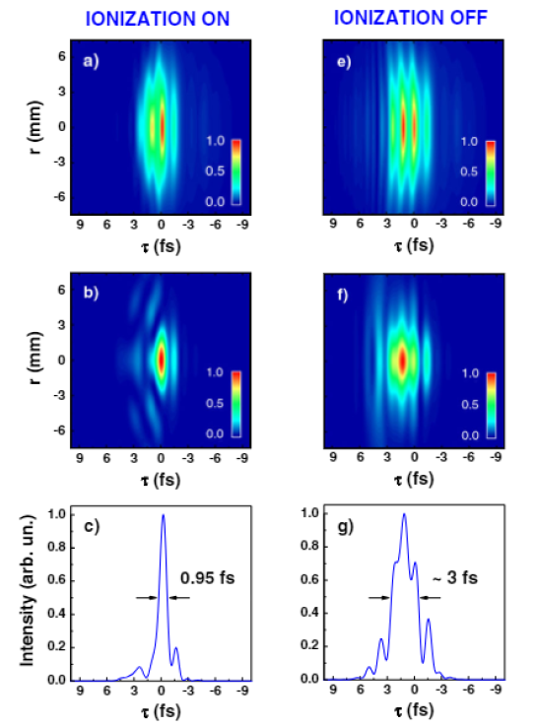
Reproducing plots from Reiter et al. 2010
In Reiter: spatiotemporal evolution shows leading-edge self-steepening in UV and trailing-edge in IR
In Reiter: Removing ionisation suppresses self-steepening and elongates pulse
Parameters: 300muJ IR pulse at 750nm; Ne cell at 9.0bar central pressure [all other parameters at “standard values”]
Compared ionised and non-ionised case
IR
UV
UV
Reiter 2010

Slide 4
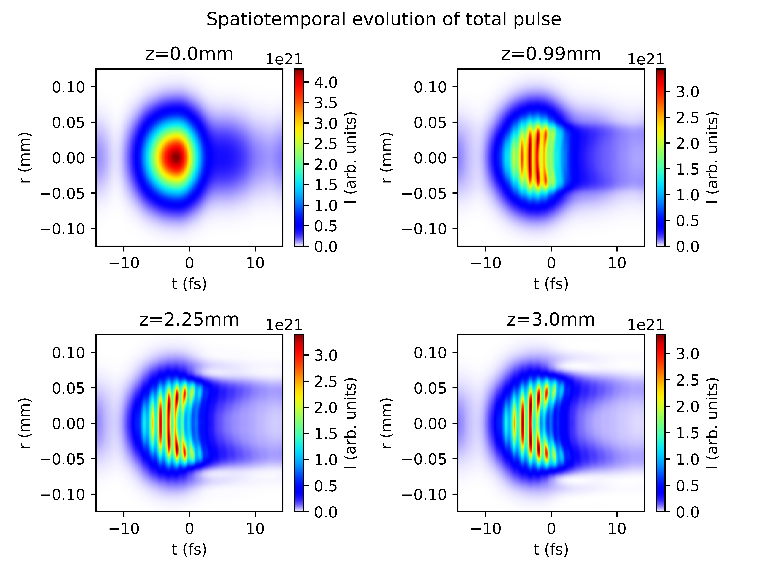
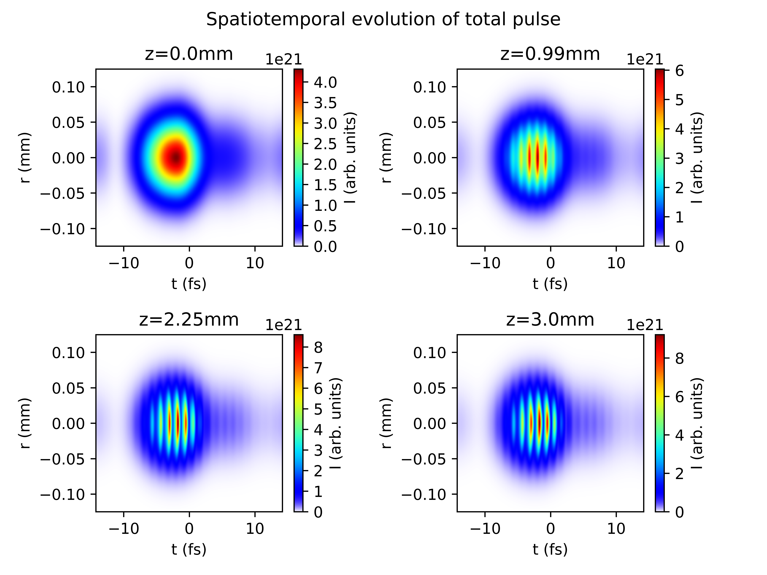
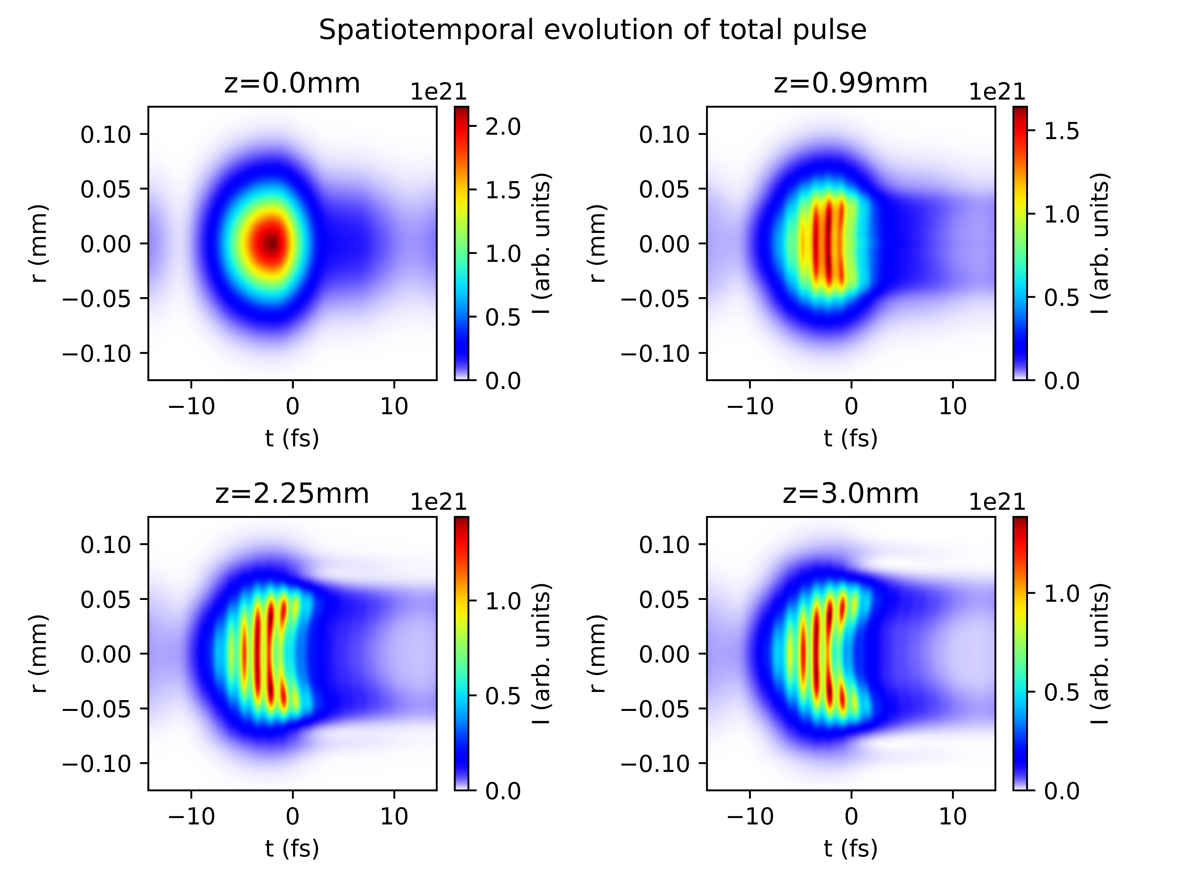
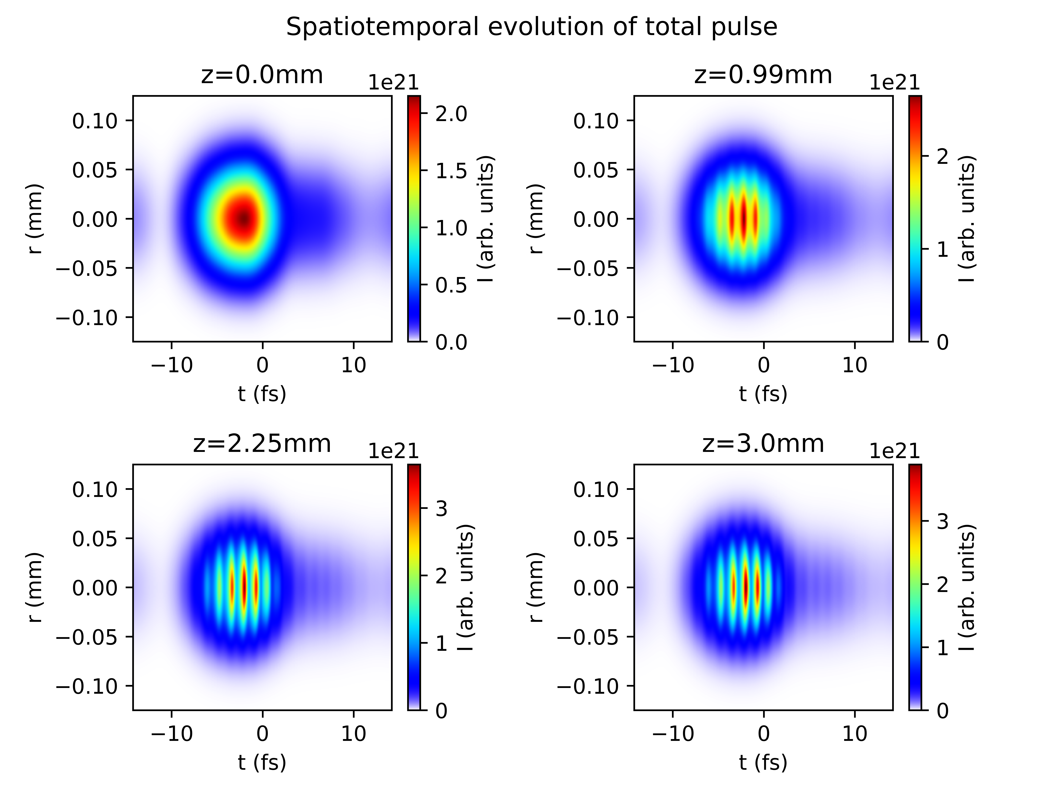
Reproducing plots from Reiter et al. 2010
With ionisation
Without ionisation

Slide 5
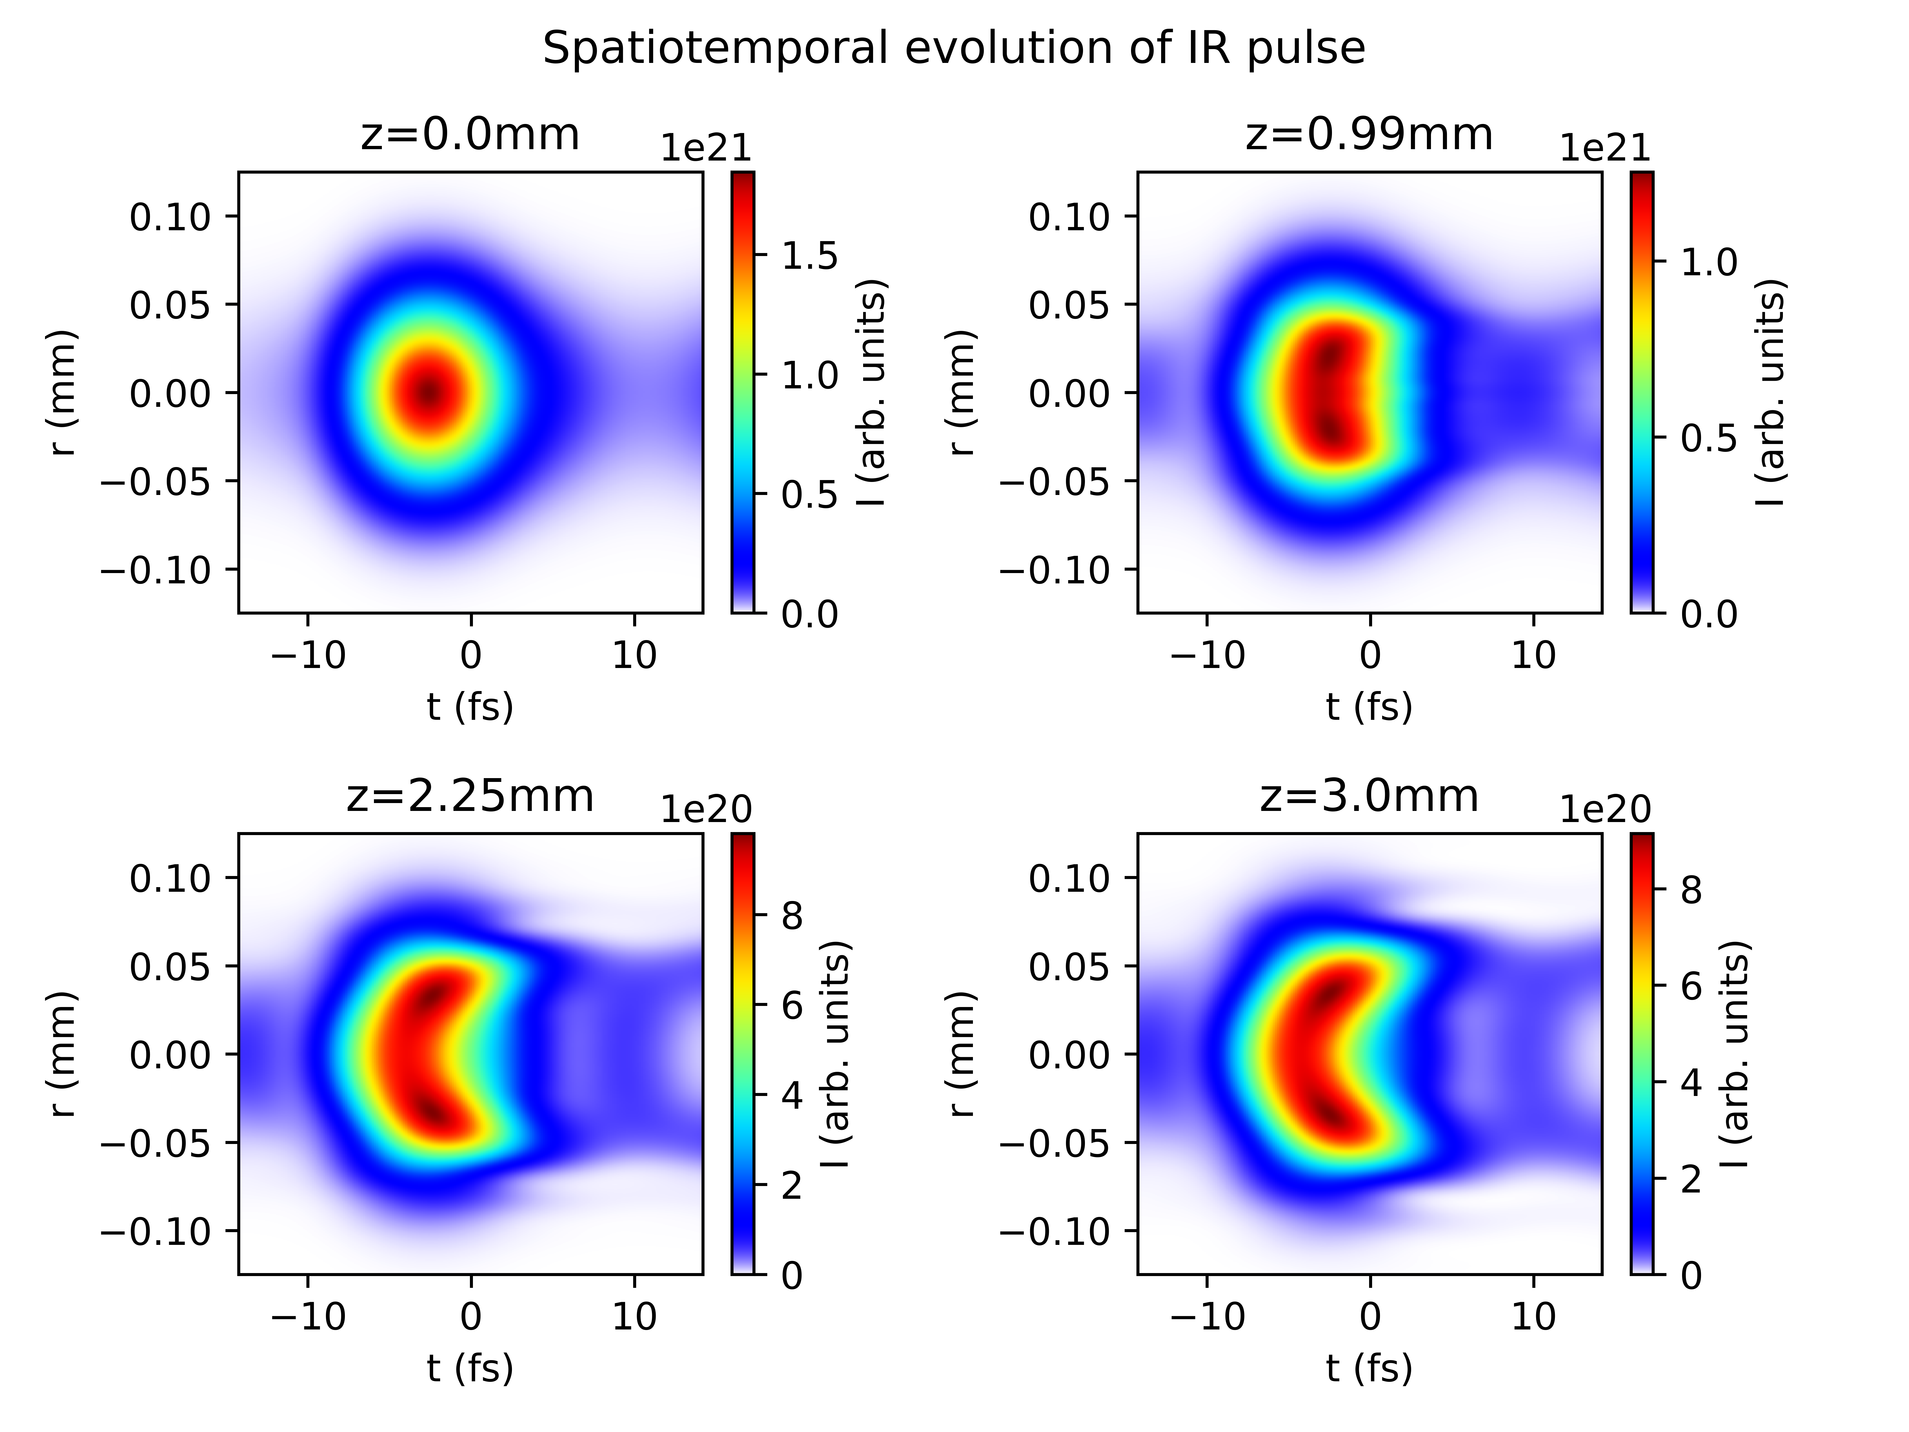
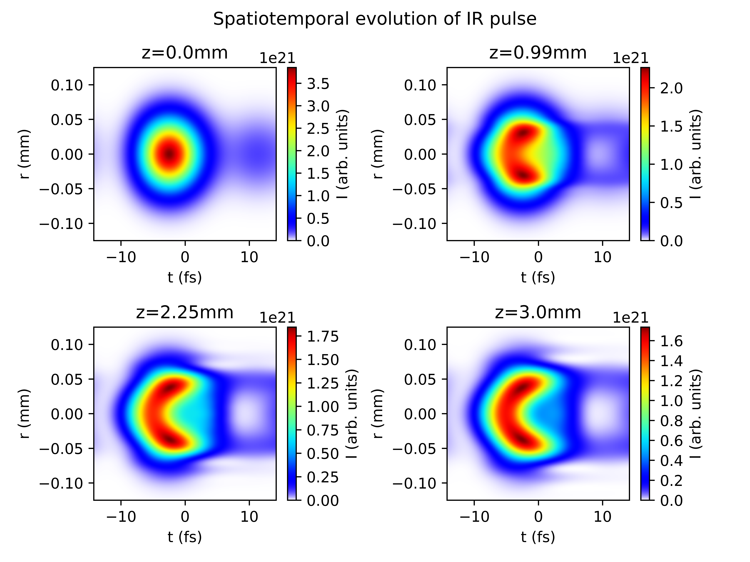
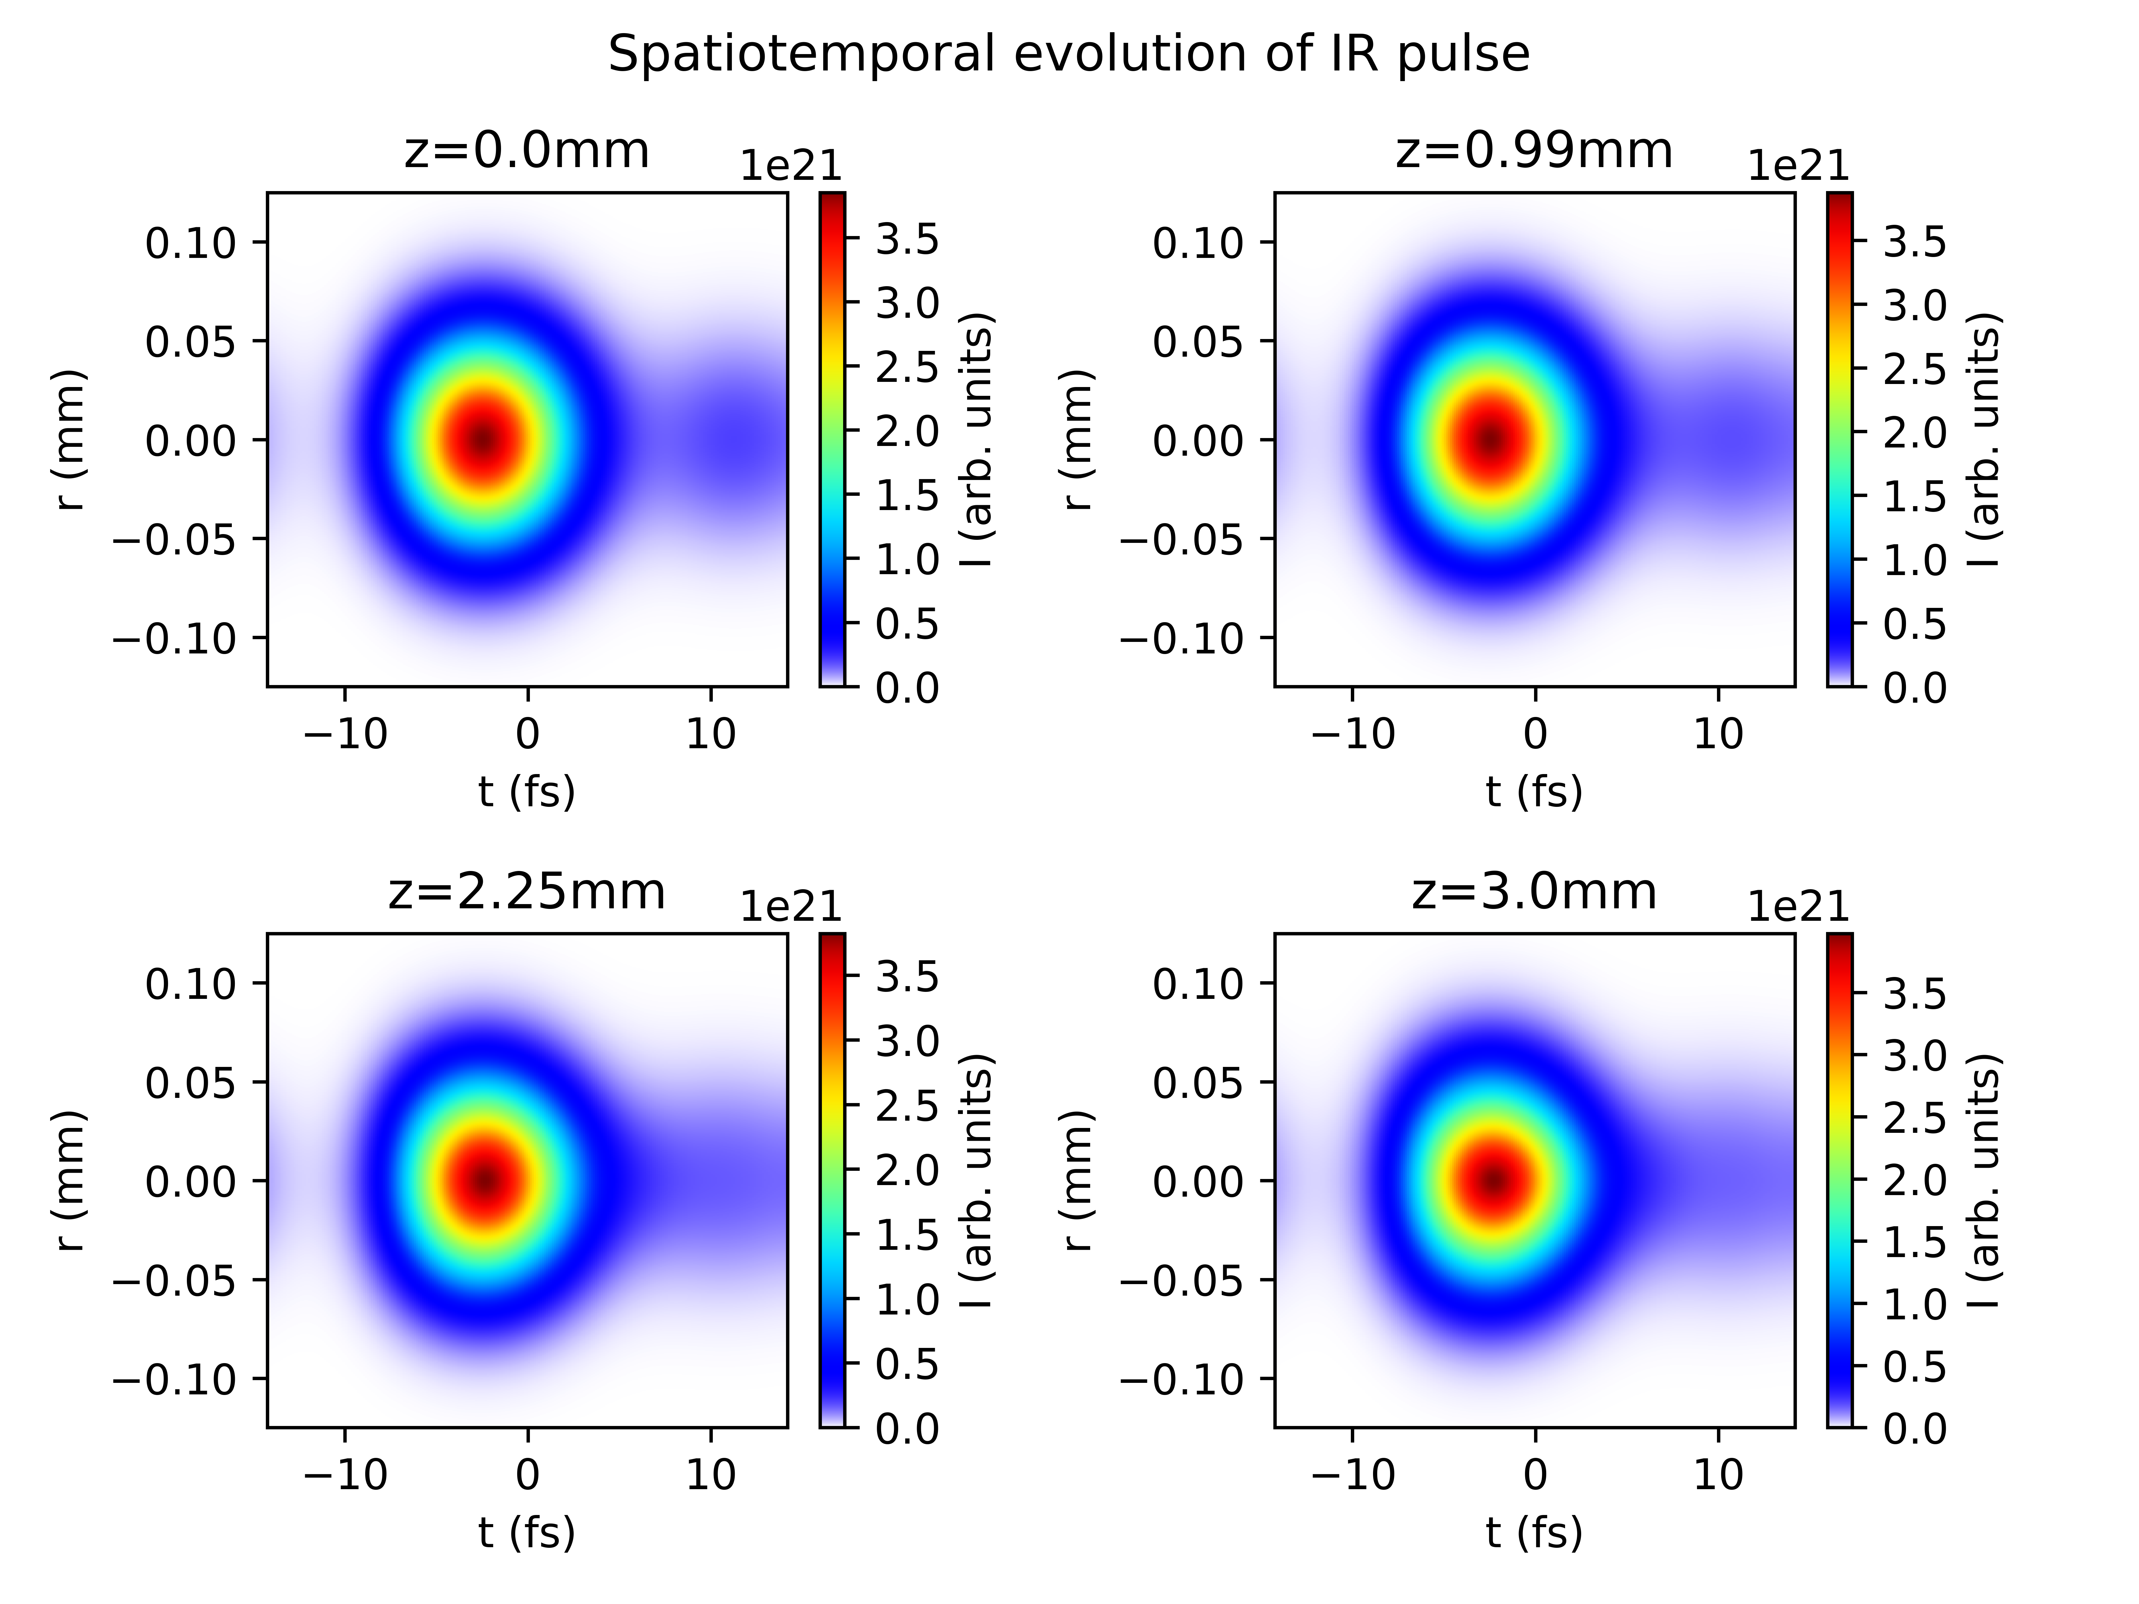
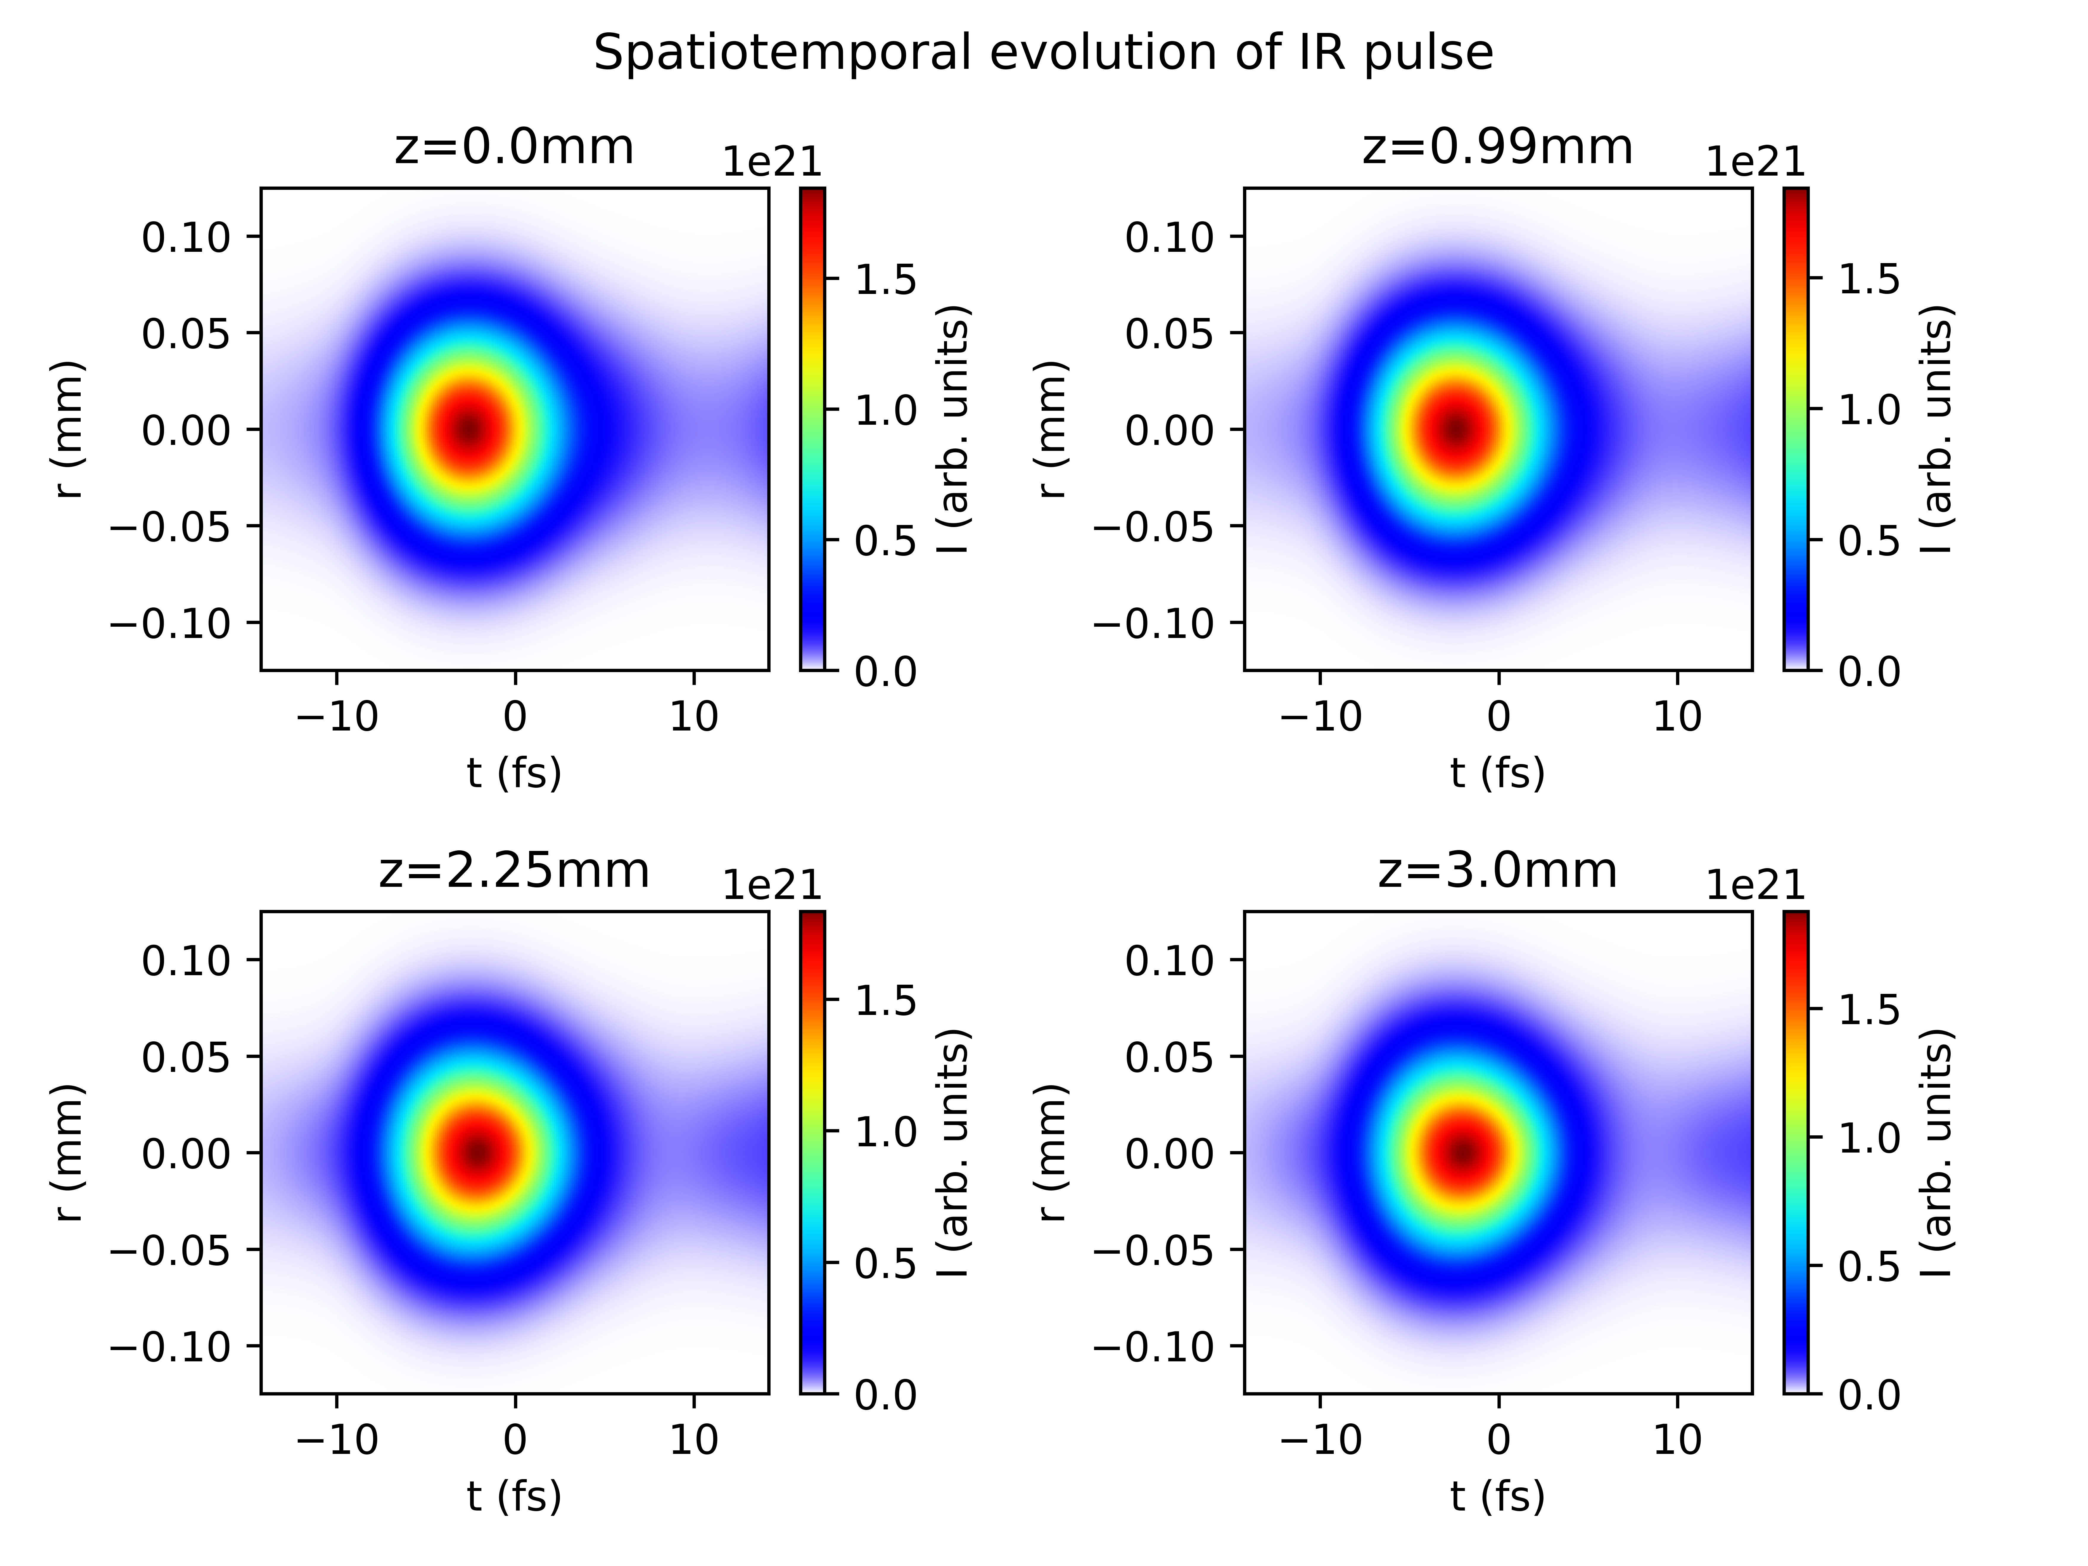
Reproducing plots from Reiter et al. 2010
With ionisation
Without ionisation

Slide 6
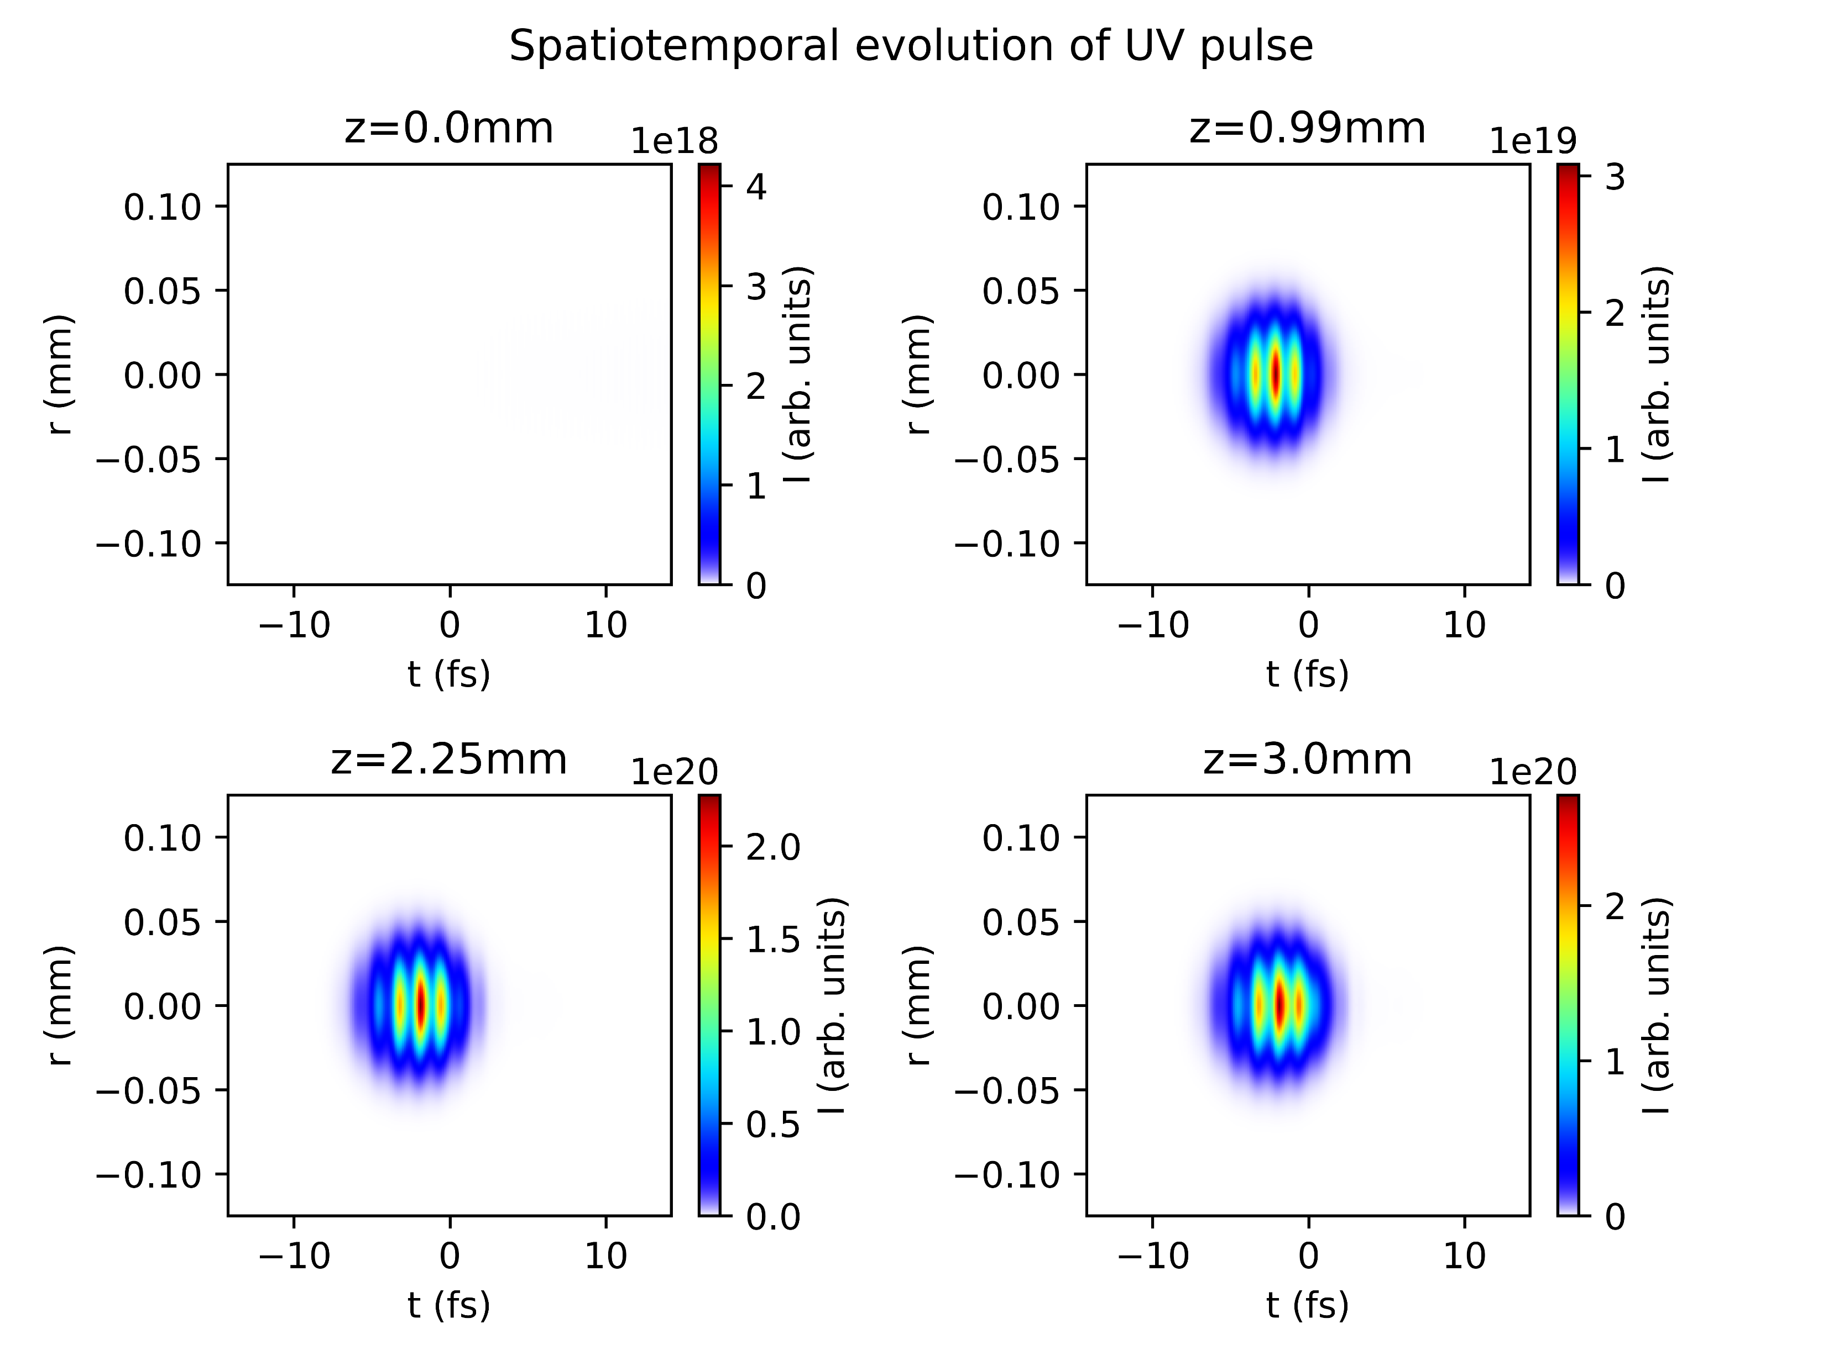
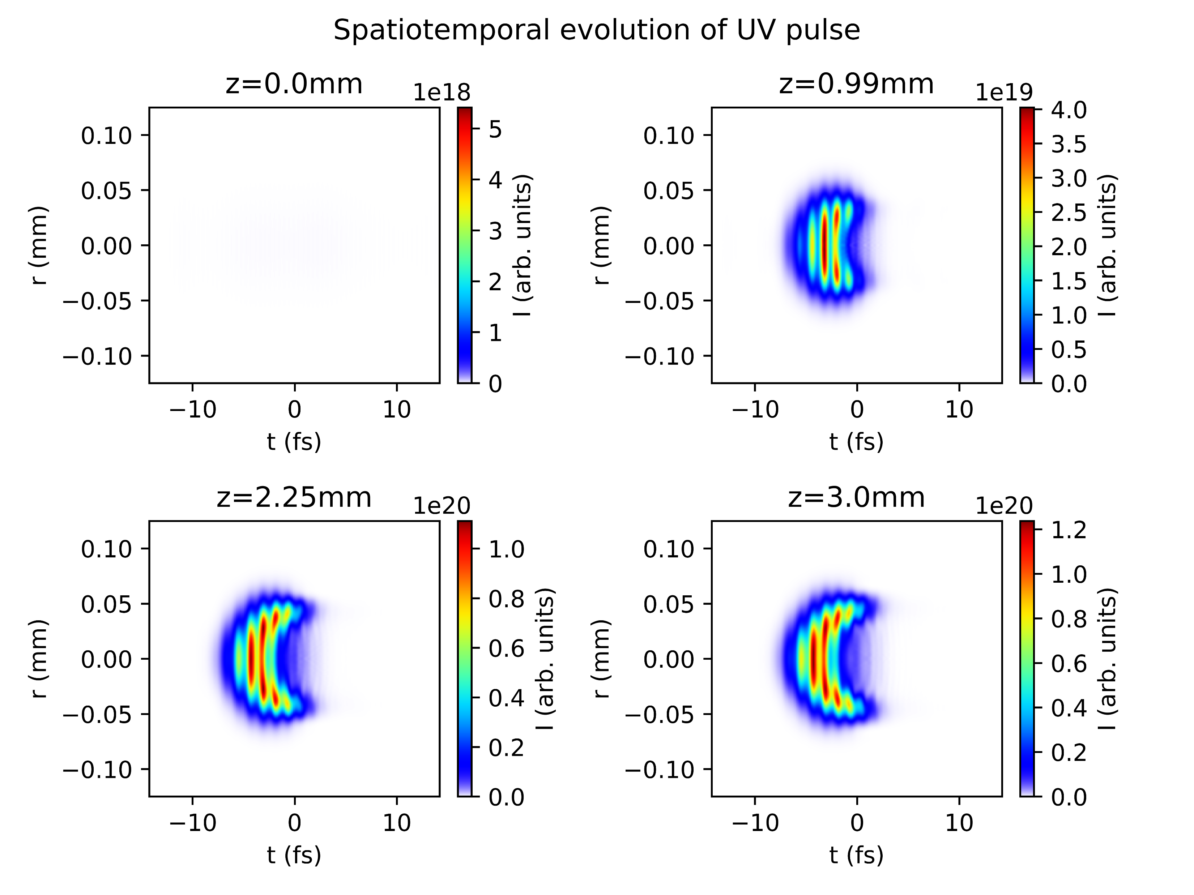
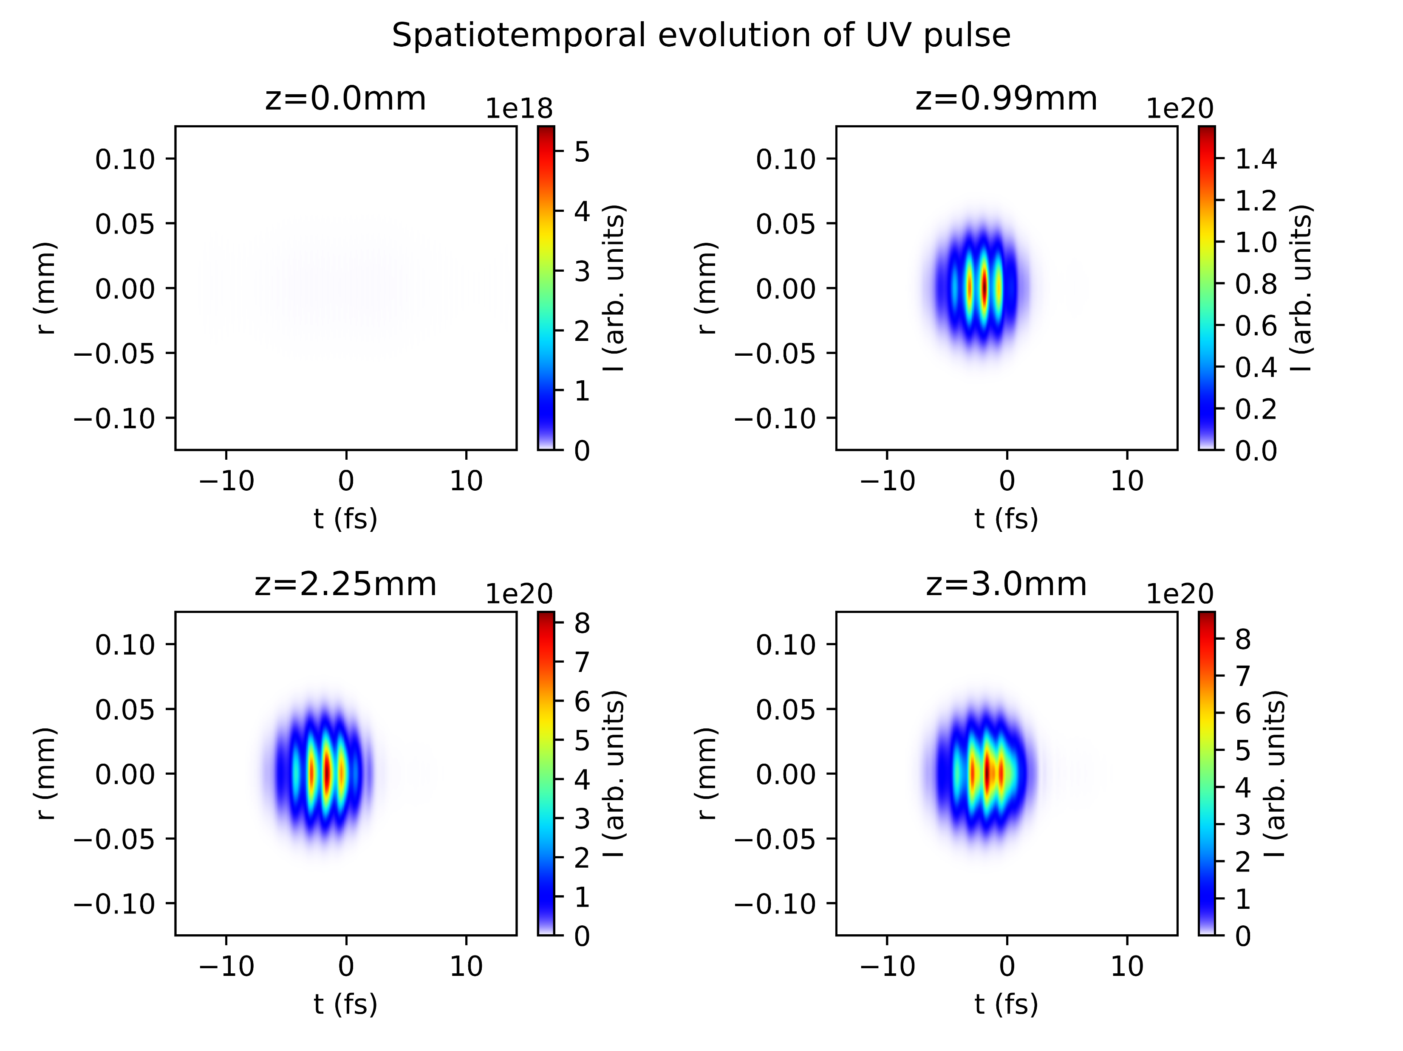

Reproducing plots from Reiter et al. 2010
With ionisation
Without ionisation

Slide 7
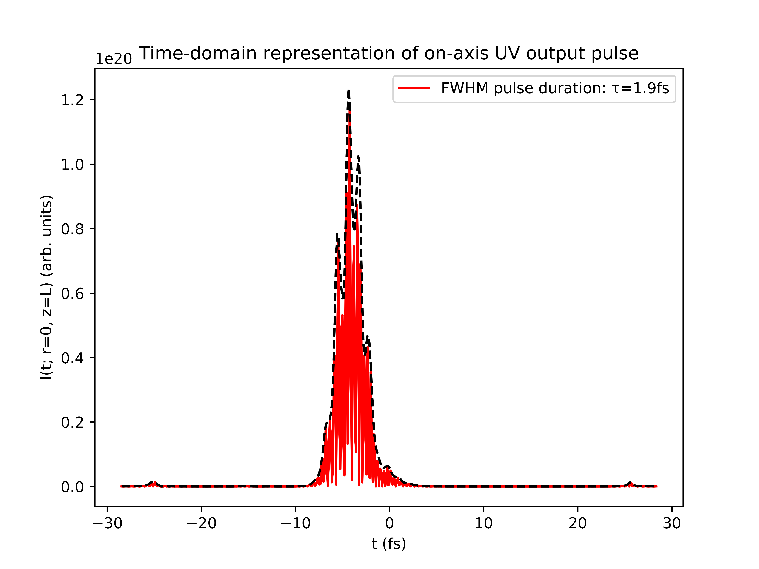
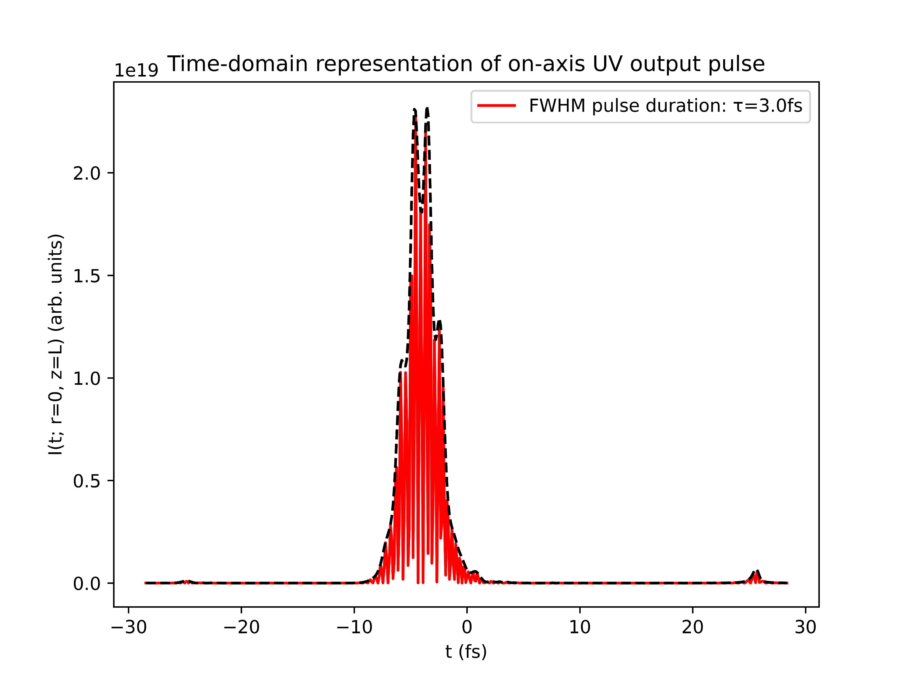
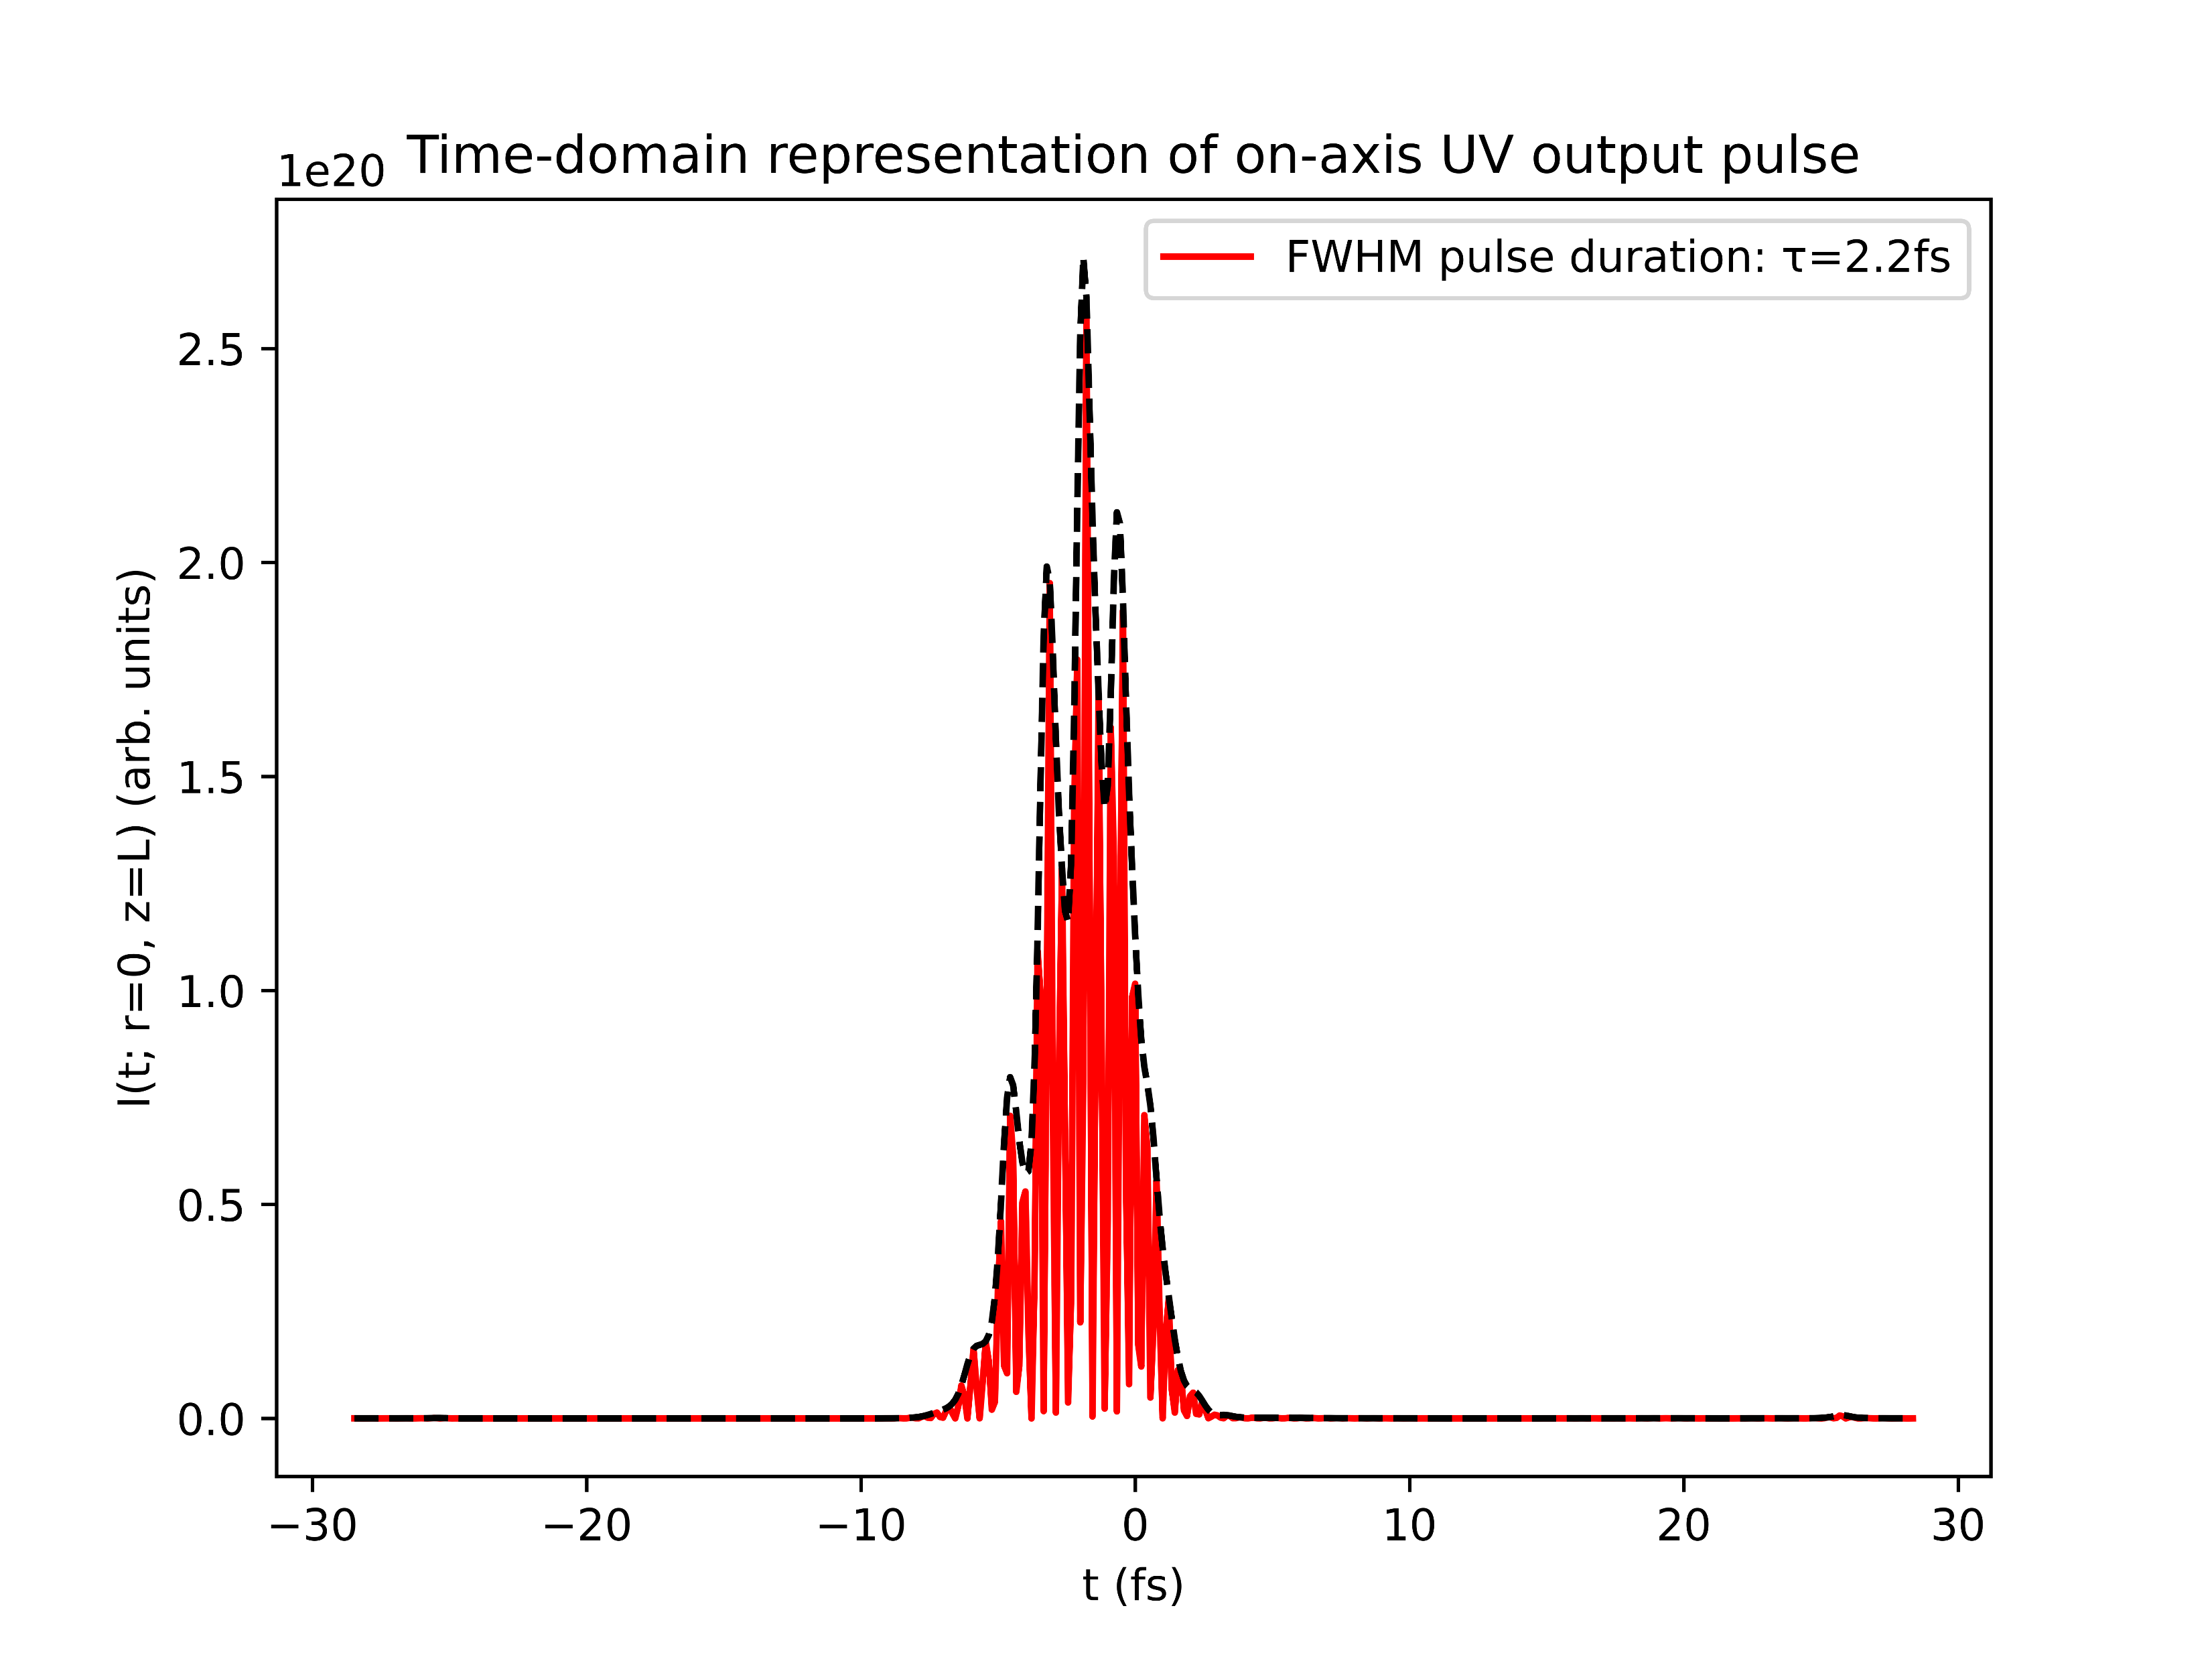
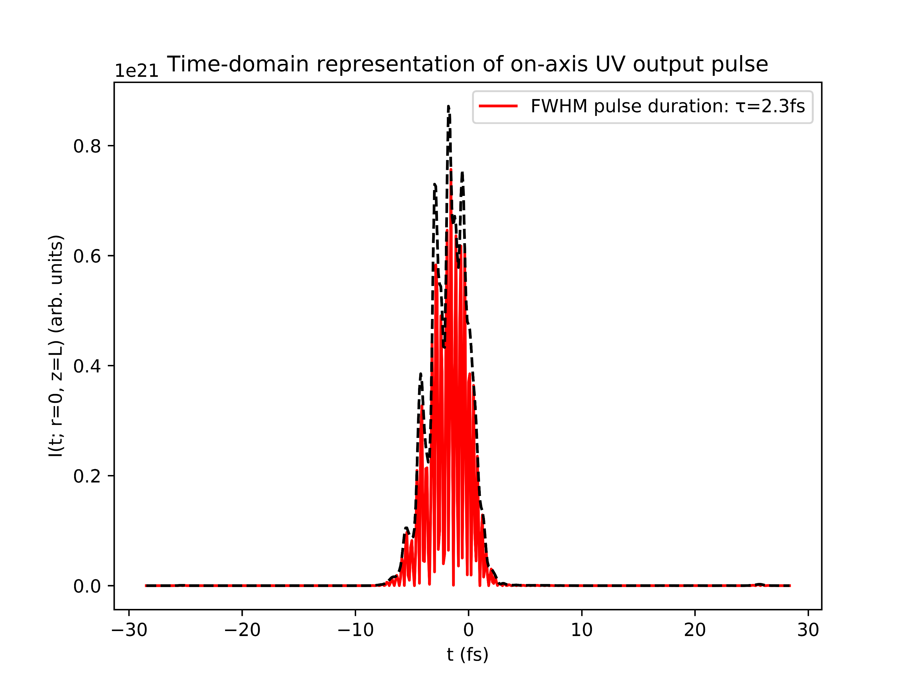
Reproducing plots from Reiter et al. 2010
With ionisation
Without ionisation

Slide 8
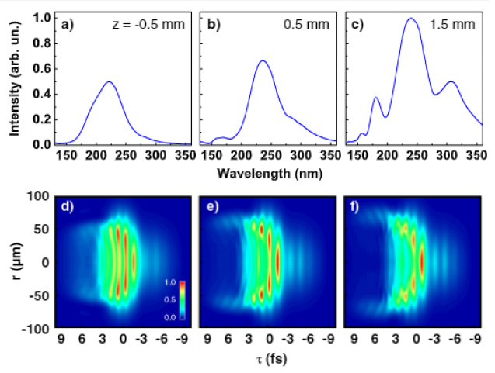
Reproducing plots from Reiter et al. 2010
Simulations show very clear trailing-edge self-steepening
Turning off ionisation mostly suppresses this effect
Unlike in Reiter, however, the UV pulse also shows trailing-edge self-steepening BUT its duration is decreased by turning off ionisation
IS THERE SMTH FUNDAMENTALLY WRONG WITH THE MODEL??
Reiter 2010 (with ionisation)

Slide 9
Testing the COMSOL simulations
Problems with grid!!

Slide 10
List items for discussion with Chris (Luna)
Lacking documentation for Nonlinear.jl response functions
in particular: how do KerrField, PlasmaCumtrapz, etc. relate to specific terms in the UPPE?
Extracting temporal/spectral phase information
Breakdown in PlasmaScalar! (CSpline DomainError in PlasmaCumtrapz)
Note: potential fix using ADK ionisation instead of PPT?
Spatial grids with z<0?

